Slide 1



Slide 2
PRESENTATION ON
WHAT YOU
WEAR IS
WHAT YOU ARE
……IS IT TRUE….
LETS
FIND IT OUT

Slide 3
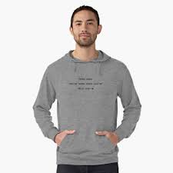
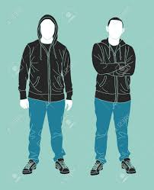
It certainly can be true. Yes, some think that it can be true that a person is what they wear. People tend to wear what they are comfortable in and what suits them. For instance, suppose a person tend to wear jeans and a sweatshirt, and we think this says a lot about the fact that he’s laid-back. The same can be said about the personality of someone who dresses up more often.

Slide 4

Some agree to a certain extent Clothes is a way of expressing ourselves, our feelings and our identities. It tells a character about the person who wears it. Clothes reveal from which group an individual belongs. It shows who you are, but it can also create stereotypes and rejection from another group of the society we live in.

Slide 5
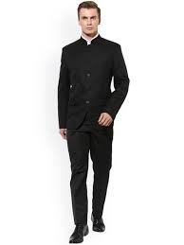
Yes it does matter See it matters how you dress up a lot , when you go to a marriage or any function you wear ethnic and your body language changes with the traditional outfit and when going for an interview in formals your body language is something else totally different your mind set too.

Slide 6

Is this true? I understand that term isn't literal but just because I'm wearing a banana costume doesn't make me a banana? If I wear all black, does that make me a goth or do I just like the colour black? What you wear doesn't define you as a person, it's what makes you individual.

Slide 7
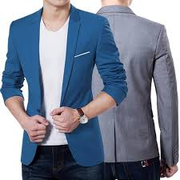
No, but what you wear does send messages Since people do judge people based on what they wear it's an important consideration but you're still not what you wear and you will not get a completely accurate understanding of a person based on their clothes. You should take the clothes to signify greater or reduced odds of traits, and then keep studying the person. Notice how conscious they seem of how their appearance might be taken. If not at all, their clothes mean less about who they are, if a great deal more about who they are OR what they are trying to portray themselves as.

Slide 8

And Finally my opinions : I would rather be diplomatic in both these cases as I believe that everything depends on situation irrespective of condition which he or she faces. Sometimes they do intentionally, aggressively and sometimes they leave the situation as it is. Any outfit might change the person’s outlook but not the real nature or character….. The personality might get affected temporarily but not permanently… For eg. – ………

Slide 9

I would like to end by making this remark- If you put a shirt on a rock it is still a rock This statement is a testimony to show the real nature remain constant irrespective of what u wear. It might help u to a certain extent which might affect your personality and character ...but it will not change your true identity and nature……….. AND THIS ALL ABOUT REGARDING ………. WHAT YOU WEAR IS WHAT YOU ARE……… NOW ITS ALL ABOUT YOU WHAT YOU CONSIDERED

Slide 10

AND WITH ALL DUE RESPECT THANK YOU FOR WATCHING……. -ShubhamGuha

